Slide 1
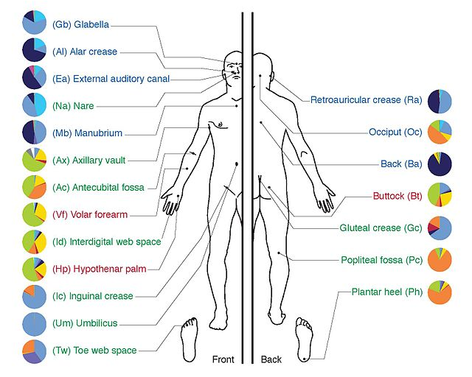
MYcrobiota:
A user-friendly application for 16S rRNA gene sequencing analysis
Stefan Boers & Saskia Hiltemann
2016-05-26

Slide 2
Why do we use the 16S gene?
Greatly enhancing our insights into the microbial diversity and taxonomy of many different types of environments and ecosystems – WHO IS THERE?
Universal gene in bacteria and archaea
Conserved regions - “species-independent” PCR amplification
Variable regions - taxonomic classification

Slide 3
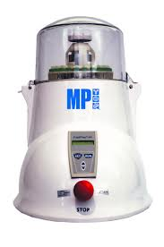
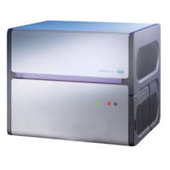

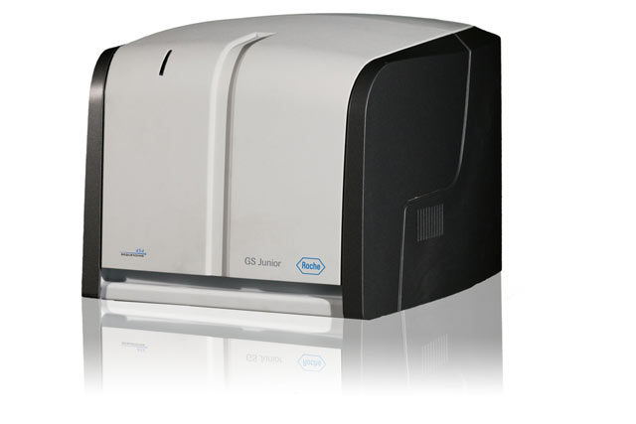

16S rRNA gene sequencing
Sampling
Extraction
Amplification
NGS
Bioinformatics

Slide 4
16S rRNA gene sequencing
Sampling
Extraction
Amplification
NGS
Bioinformatics
Every step in this process could have serious impact on the microbiota results
Topic of today: Bioinformatics

Slide 5
Bioinformatics
Roche 454 GS Junior: ~ 100.000 reads
Illumina MiSeq: ~ 25.000.000 reads

Slide 6
Workflow
Pre-processing
Artefact removal
Taxonomy assignment
Results
OTU clustering

Slide 7
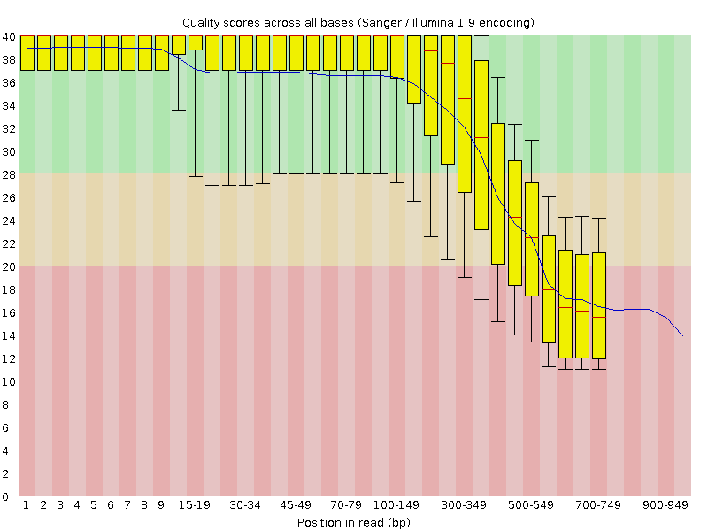
Pre-processing
Good
Okay
Bad
There are a lot of options to filter and trim your data…
However, this does not always improve things as we lose information!

Slide 8
Chimera formation
Genome Res, 2011, 21: 494-504

Slide 9

Chimera removal
Query
Chunk
Chunk
Chunk
Chunk
Hits
Chimera
Normal
A
A
Query
Query
B
Bioinformatics , 2011, 27 (16): 2194-2200

Slide 10
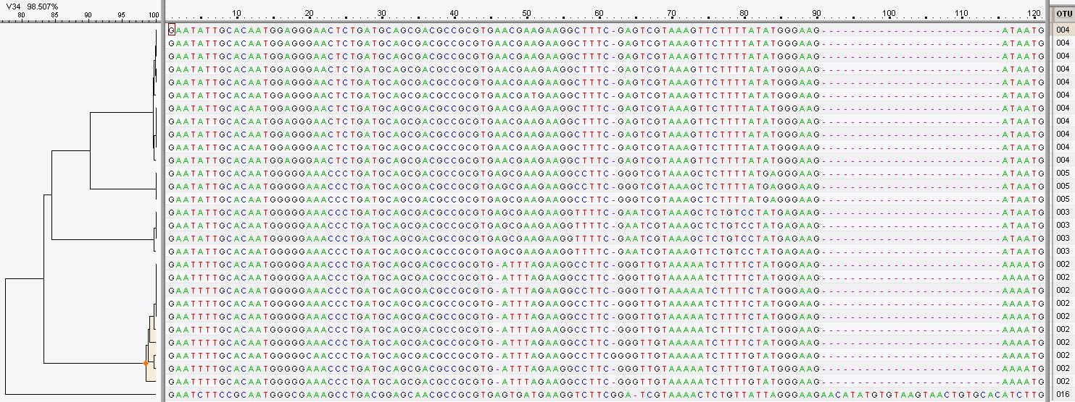
OTU Clustering
Clustering on basis of homology of the reads
97%

Slide 11


Assign taxonomy
Homology with reference databases
Accuracy depends on quality and completeness of databases used
Databases are inevitably incomplete
Manual evaluation recommended (e.g. NCBI blast)
Berkeley lab
August 2013
202,421 entries
Max-Planc-Institut
July 2015
172,418 entries

Slide 12
Results
Sci Rep, 2015, 5: 14181

Slide 13
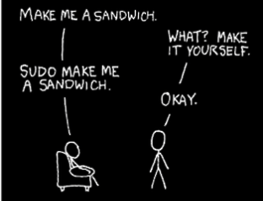
How to do all that?
Two pieces of very sophisticated open source software:
mothur
QIIME
Both programs are driven from the command line
Requires bioinformatics skills
Results depend on algorithms used and their settings
Development of MYcrobiota:
Translation of a validated workflow in a user-friendly (automated) pipeline
“Plug and Play” – standardized algorithms and settings
Quality control – where did I lose reads and the ability to download them to check!
Dynamic visualization of bacterial taxonomies and alpha/beta diversities

